Slide 1
Ministry of Electronics & Information Technology
Government of India
शक्ति
वेगा
4th Interactive Webinar on
स्वदेशी Microprocessor Challenge - Innovate Solutions for #आत्मनिर्भर भारत

Slide 3
Updates on स्वदेशी Microprocessor Challenge

Slide 4
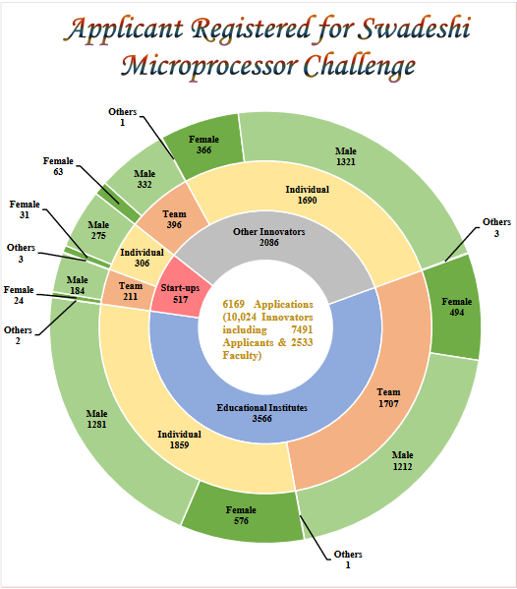

Slide 5
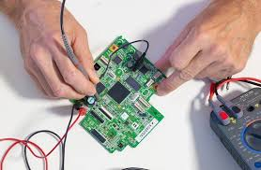
Timelines of स्वदेशी Microprocessor Challenge
Semi-Final Starts
Registration Closed/ Quarter-Final Begins
Final Begins
18 Aug’20
02 Dec’20
10 May’21
30 July’ 21
30’ Sep 20
15 Feb’21
15 May’21
Results Announced in July’ 21
Registration Open
Final End
Quarter-Final End
Semi-Final End

Slide 6
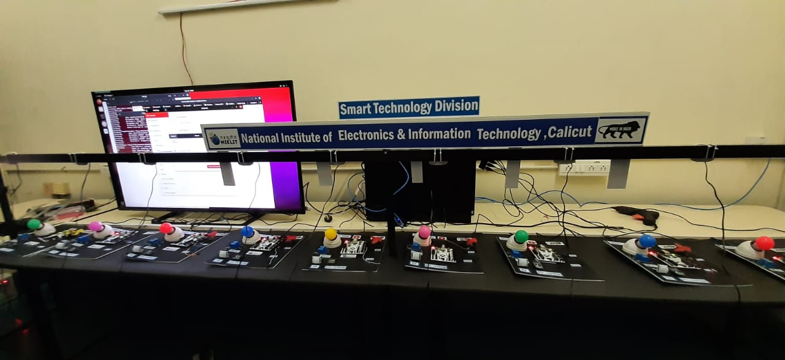
Training on Embedded System Design on FPGA using Swadeshi Microprocessors Recorded Lectures available @ http://smdpc2sd.gov.in/iep_14

Slide 8
Stats on 2 Trainings on Embedded System Design on FPGA using Swadeshi Microprocessors
Another round of Training planned shortly based on the interest of applicants
Recorded Lectures available @ http://smdpc2sd.gov.in/iep_14

Slide 9
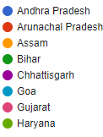
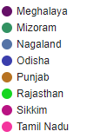
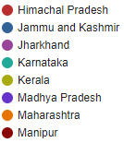
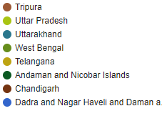
Stats on 2 Trainings on Embedded System Design on FPGA using Swadeshi Microprocessors
Another round of Training planned shortly based on the interest of applicants

Slide 10
Walk-through on steps of the Semi-Final Stage
Quarter Final
01st Oct- 25th Dec’20
Pre-Screening Stage: Abstract submission & solving a Quiz by 25/10/20
Ideate Stage: Detailed proposal submission by 25/12/20
Finals
15th May- 30th July’21
25 Teams to get total Rs. 1.0 Cr of Prototype development fund
Monthly reviews & mentoring.
Hw Prototype Stage: demonstration on 30/07/21
01
03
05
02
04
Registration
18th Aug-30th Sep’20
Challenge Launch on 18/08/20
Registration closes on 30/09/2020
Semi Final
15th Feb- 10th May’ 21
100 Teams to get free access to Swadeshi Processors & FPGA Boards and total Rs. 1.0 Cr of MVP/ POC development fund
Monthly reviews & mentoring
MVP/ POC Stage: demonstration on 10/05/21
Incubation
Aug’21-June’22
Top 10 Teams to get Rs. 2.30 Cr including:
Milestones linked Seed fund support for developing Product.
12-Month Incubation Support.
11 Months

Slide 11
Number of Teams participating during various Stages of the Challenge
Online Quiz
Abstract
Proposal
PoC
Hw Prototype
6170 Teams
1400 Quarter Finalists
1200 Quarter Finalists
100 Semi-Finalists
25 Finalists
10 Winners

Slide 12
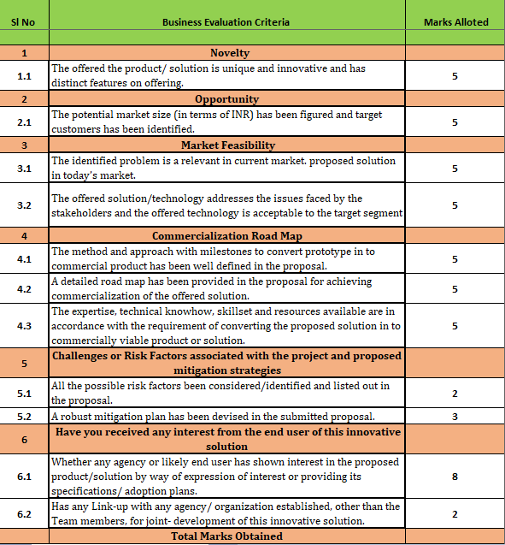
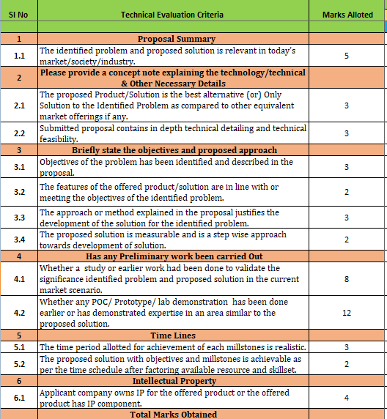
3-tier Evaluation Criteria adopted in Quarter Finals involving 250+ Experts
(Business & Technical Viability)

Slide 13
Stats of 100 Semi-Finalists
Category-wise Breakup of 100 Semi-Finalists
Processor-wise Breakup of 100 Semi-Finalists
FPGA-wise Breakup of 100 Semi-Finalists

Slide 14
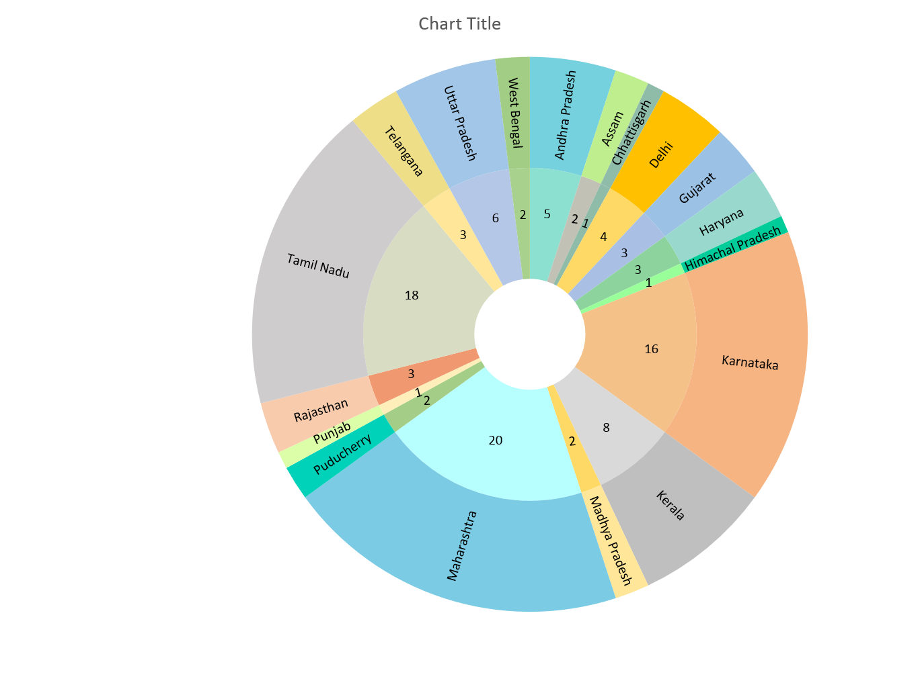
Geographical Breakup of 100 Semi-Finalists

Slide 15
Details of Hw/ Sw & Financial support in Semi-Finals
FPGA Board ported with one of the Processor IPs, based on following confirmations the Team Leader (SPOC):
Confirmation of the Communication/ Postal Address via email response.
Confirmation of the FPGA/ Processor IP selected in the detailed proposal via email response-
SHAKTI: Vajra (C64-A100), Parashu (E32-A100) or Pinaka (E32-A35)
VEGA: AS1061 or ET1031
Rs. 1.00 Lakh to each Semi-Finalist for development of POC, based on following details to be provided by the Team Leader (SPOC):
Bank Details of the Start-up for depositing the funds.
Tentative plans to utilize the funds as per prescribed Proforma.
Tentative plans to utilize funds by 22nd February 2021
Progress Report submission by 31st March 2021
POC/ MVP demonstration on 10th May 2021

Slide 16
Contact us !
For general queries related to the Challenge, please contact swadeshi.processor@meity.gov.in or post at discussion forum @ https://groups.io/g/sp2020-general/topics
For queries related to SHAKTI processor Ecosystem, please post at discussion forum @ https://shakti.org.in/sp2020-shakti.html
For queries related to VEGA processor Ecosystem, please post at discussion forum @ https://groups.io/g/sp2020-vega/topics
For concerns, please write to swadeshi.processor@meity.gov.in

Slide 17
Walk-through on the Process of Start-up Registration

